Slide 1
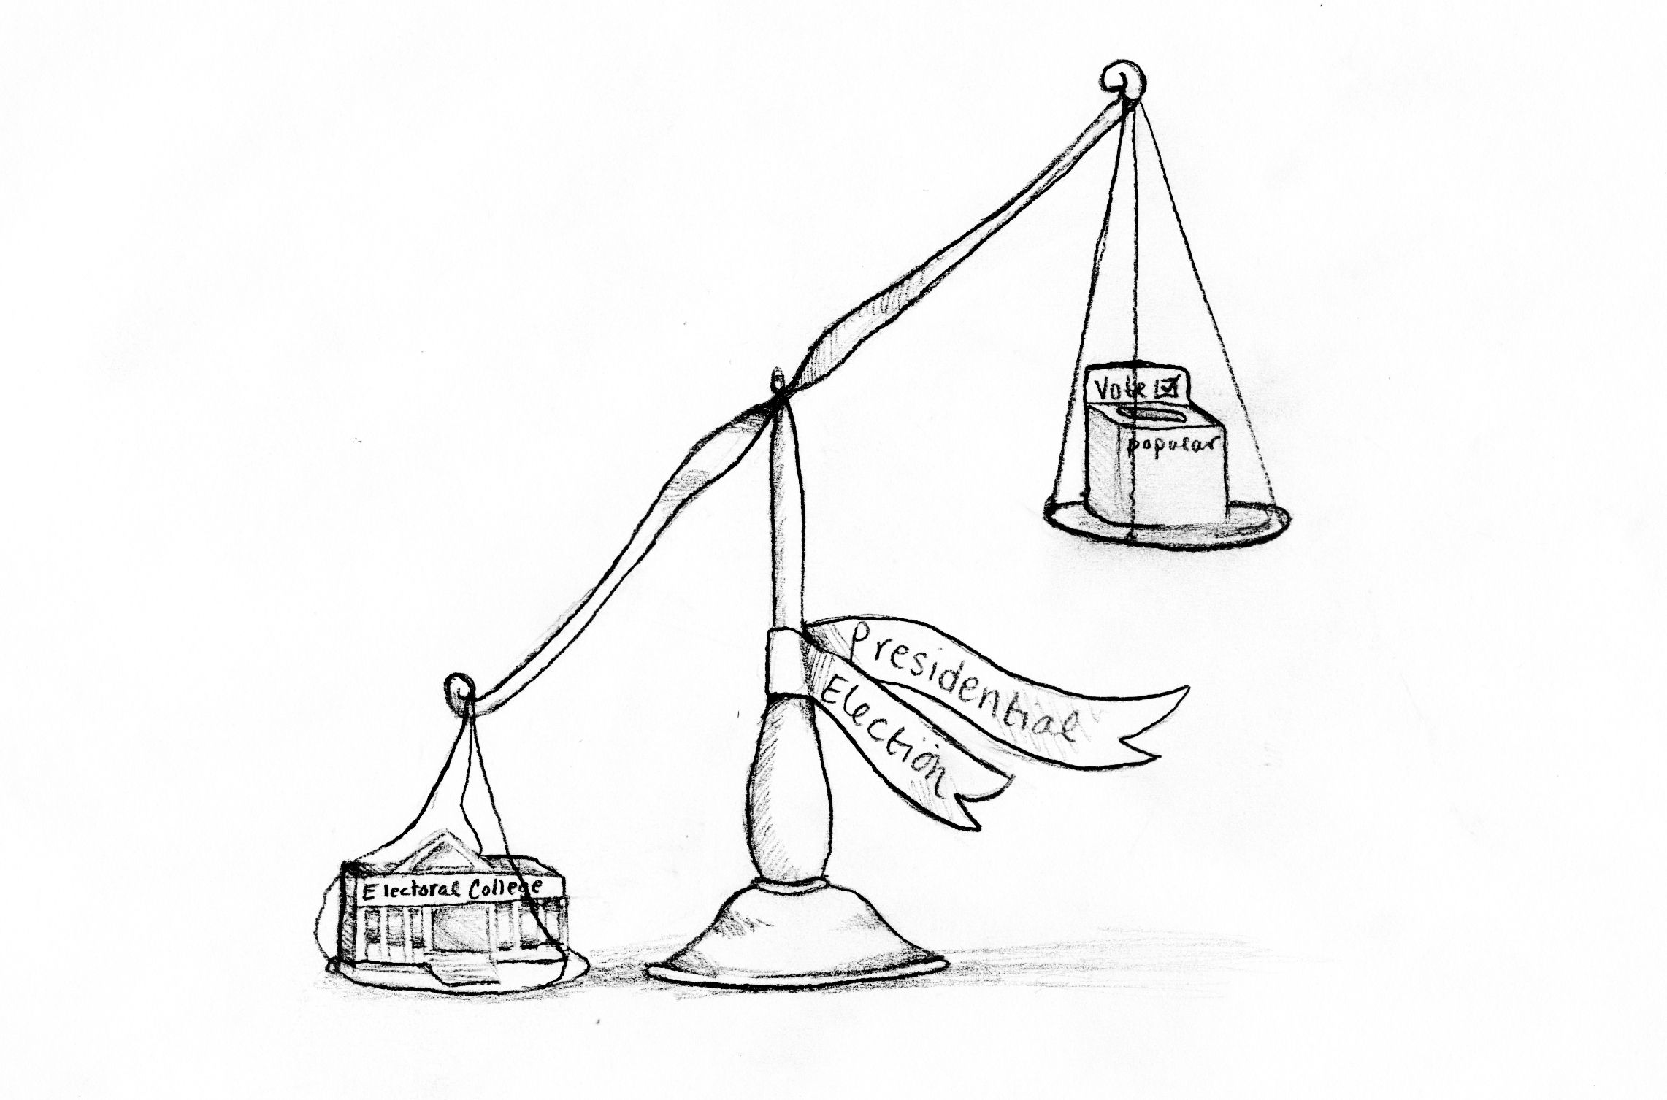
5/15 Warm Up
What happens in the Electoral College?

Slide 2
Objective
Assess knowledge of content that might appear on the HSA government exam

Slide 3
Exam date: Monday, May 18th
AM exams
MC Lab: A – Cre
A200: Dav – Hou
A202: Jor – Mer
A215: Moo – Sag
MC Floor: San - You

Slide 4
Constructed Responses
Whaaaaaaat?

Slide 5
The Rubric – a top score =s 4
This response shows understanding of the content, question, and/or problem. The response is insightful, integrates knowledge, and demonstrates powerful application.
The application shows powerful evidence of higher order thinking skills.
Concepts are accurate and well supported.
There are no misconceptions.
The response is comprehensive.
Meaning you say more than they are asking for

Slide 6
Step one: Read the Question
In a civil case, plaintiffs and defendants often reach out-of-court settlements instead of bringing a case to trial.
Describe the advantages and disadvantages of an out-of-court settlement.
Should judges and attorneys encourage out-of-court settlements? Explain why or why not.
Include details and examples to support your answer.
What is this question asking you to do?
What is main topic of this question?

